Slide 1
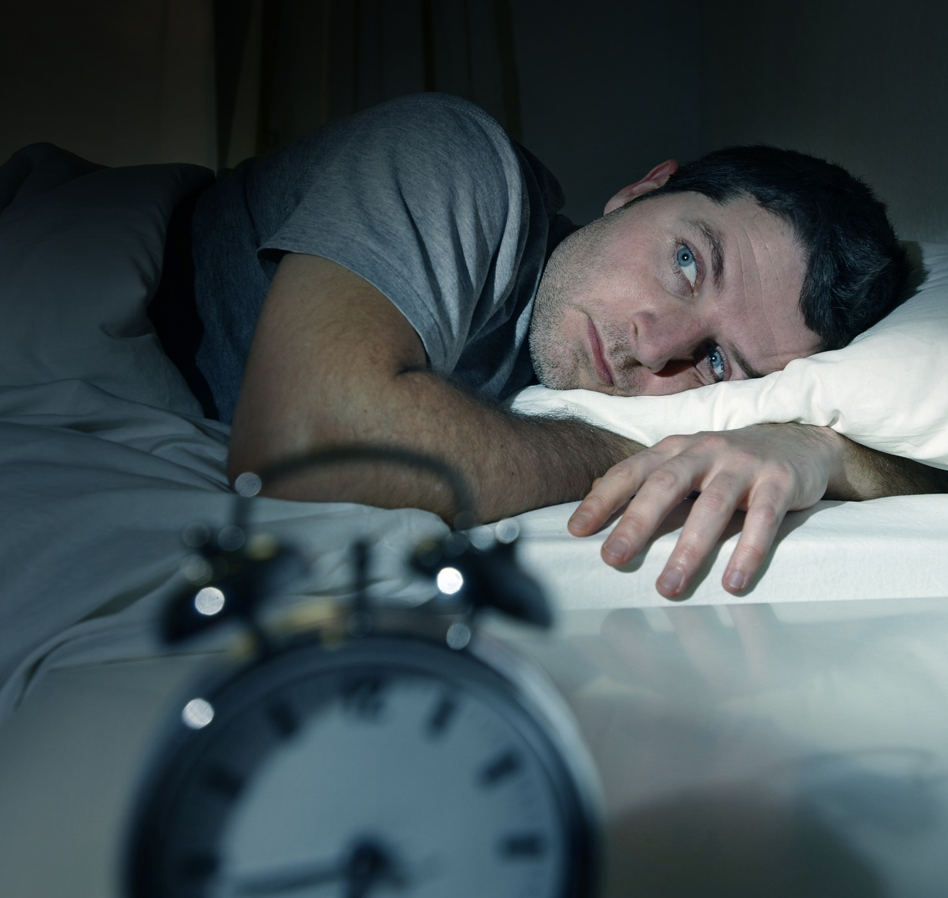
Sleep disorders
Deepak Neelam, Alexandra Perez, and Nathan Tatko
ThePhoto by PhotoAuthor is licensed under CCYYSA.

Slide 2
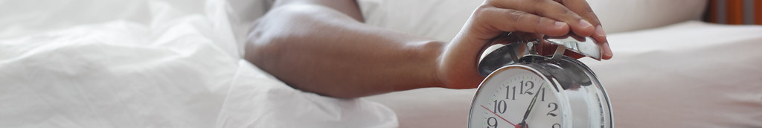
Introduction
Sleep disorders are conditions that affect or disturb normal sleep patterns.
Sleep apnea
Insomnia
1 in 3 adults do not regularly get the recommended amount of uninterrupted sleep they need to protect their health (NIH).
Risks (Mayoclinic):
Can worsen or increase risk of heart disease, stroke, and diabetes.
Can affect your quality of life
ThePhoto by PhotoAuthor is licensed under CCYYSA.
Notes:
Nathan

Slide 3
Our Dataset:
Sleep, Health, and Lifestyle Dataset created by Laksika Tharmalingam on Kaggle
400 Rows
13 Columns
All columns pertain to sleep, activity levels, and general health
Person ID | Gender | Age | Occupation | Sleep Duration | Quality of Sleep | Physical Activity Level | Stress Level | BMI Category | Blood Pressure | Heart Rate | Daily Steps | Sleep Disorder
1 | Male | 27 | Software Engineer | 6.1 | 6 | 42 | 6 | Overweight | 126/83 | 77 | 4200 | None
2 | Male | 28 | Doctor | 6.2 | 6 | 60 | 8 | Normal | 125/80 | 75 | 10000 | None
3 | Male | 28 | Doctor | 6.2 | 6 | 60 | 8 | Normal | 125/80 | 75 | 10000 | None
4 | Male | 28 | Sales Representative | 5.9 | 4 | 30 | 8 | Obese | 140/90 | 85 | 3000 | Sleep Apnea
5 | Male | 28 | Sales Representative | 5.9 | 4 | 30 | 8 | Obese | 140/90 | 85 | 3000 | Sleep Apnea
6 | Male | 28 | Software Engineer | 5.9 | 4 | 30 | 8 | Obese | 140/90 | 85 | 3000 | Insomnia
7 | Male | 29 | Teacher | 6.3 | 6 | 40 | 7 | Obese | 140/90 | 82 | 3500 | Insomnia
8 | Male | 29 | Doctor | 7.8 | 7 | 75 | 6 | Normal | 120/80 | 70 | 8000 | None
9 | Male | 29 | Doctor | 7.8 | 7 | 75 | 6 | Normal | 120/80 | 70 | 8000 | None
10 | Male | 29 | Doctor | 7.8 | 7 | 75 | 6 | Normal | 120/80 | 70 | 8000 | None
11 | Male | 29 | Doctor | 6.1 | 6 | 30 | 8 | Normal | 120/80 | 70 | 8000 | None
Notes:
Nathan

Slide 4

Goals:
We aim to explore the relationship between the data and presence of a sleep disorder:
Increase in stress levels would lead to an increase in the probability of having a sleep disorder.
As the participants get older, they have a higher probability of having a sleep disorder.
Increased activity levels would lead to a decrease in the probability of having a sleep disorder.
Notes:
Alex

Slide 5
Data Preprocessing
Features:
• Demographic: Gender, Age, Occupation
• Sleep: Sleep Duration, Quality of Sleep, Sleep Disorder
• Lifestyle: Physical Activity Level, Stress Level, Daily Steps
• Health: BMI Category, Blood Pressure, Heart Rate
•Converted Sleep Disorder into binary (1: Disorder, 0: None).
•Engineered new features:
Blood Pressure Binary: High BP (Systolic ≥ 130 or Diastolic ≥ 80).
BMI Binary: Overweight/Obese vs. Normal/Underweight.
Occupation Grouping: Health-related, IT/Tech, Sales/Finance, Other.
Notes:
Deepak

Slide 6
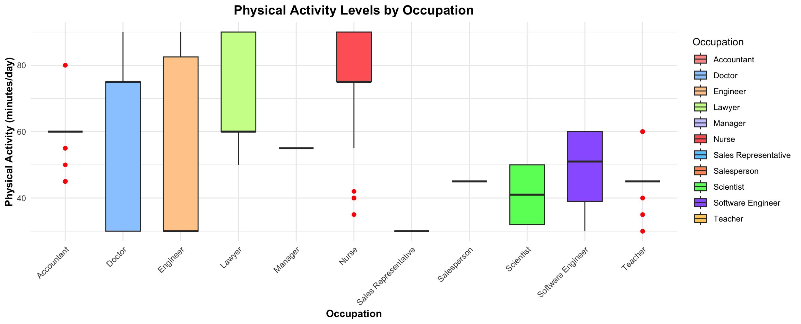
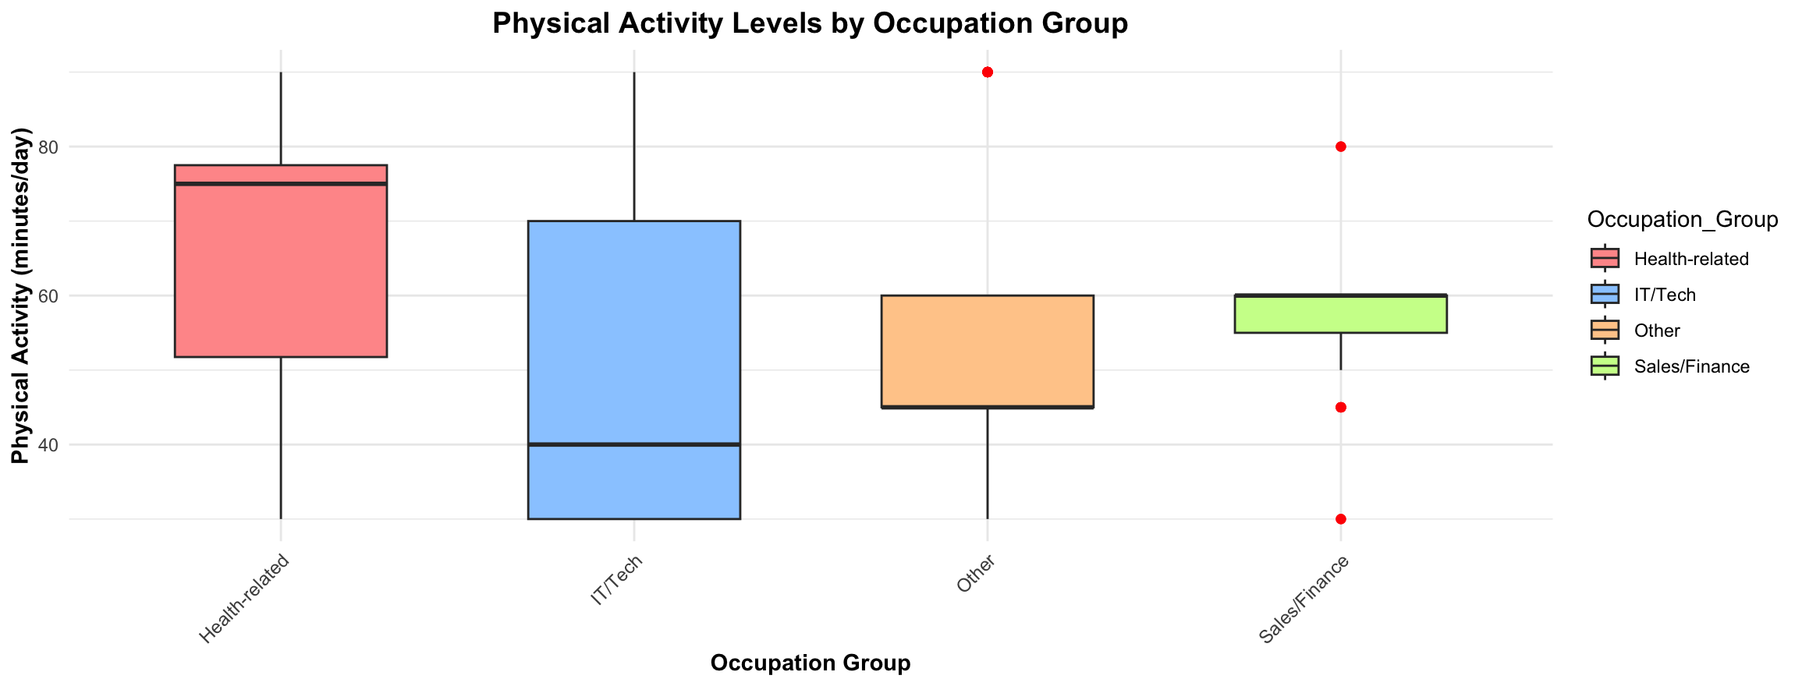
Box plots before grouping Occupation
Box plots After grouping Occupation
Notes:
Deepak

Slide 7
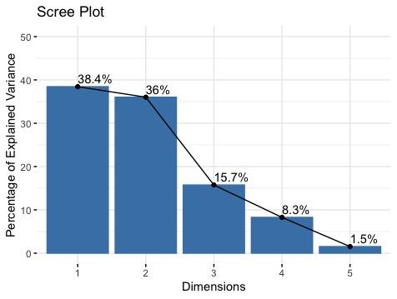
How is the Quality of Sleep Affected by Age, Physical Activity Level, Stress Level, Heart Rate and Daily Steps?
Notes:
Deepak

Slide 8
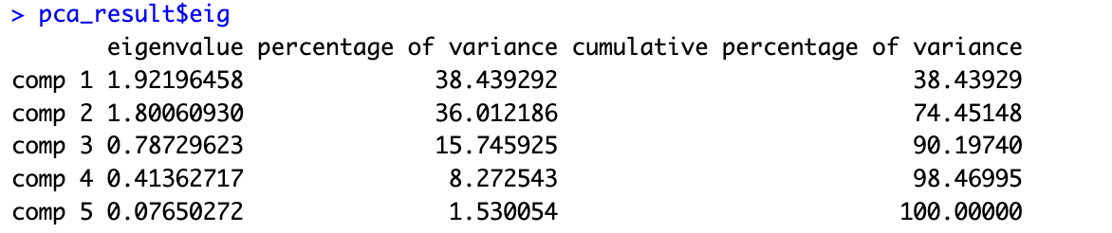
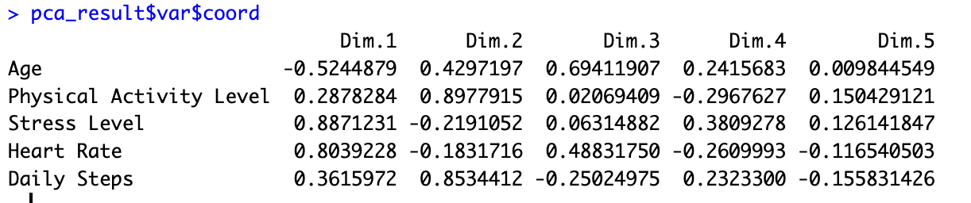
Results: PCA
Notes:
Deepak

Slide 9
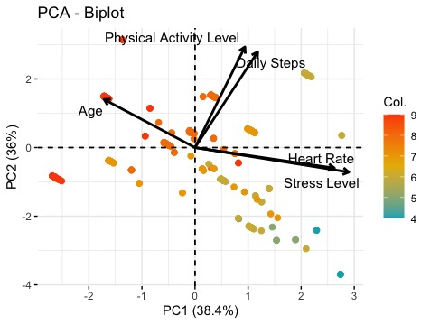
PCA - Biplot
Notes:
Deepak

Slide 10
Methods: MANOVA
Performed One-Way MANOVA using Wilks Lambda test
Tested difference in means of all continuous variables for the Sleep Disorder and No Sleep Disorder groups
Tested difference in means of variables involving physical activity for the Sleep Disorder and No Sleep Disorder groups

Slide 11
Results: Manova
All Continuous Predictors
Physical Activity Predictors
 | DF | Wilks | Approx F | Num DF | Den DF | Pr(>F)
Sleep Disorder | 1 | 0.37626 | 86.675 | 7 | 366 | < 2.2e-16
Residuals | 372
 | DF | Wilks | Approx F | Num DF | Den DF | Pr(>F)
Sleep Disorder | 1 | 0.97905 | 3.9702 | 2 | 371 | 0.01968
Residuals | 372

Slide 12
Methods: Classification
Split data into training and testing sets using Data Partition
Used Linear Discriminant Analysis and Quadratic Discriminant Analysis models to predict sleep disorders
Models contained only the continuous and binary predictors
Utilized Logistic Regression to identify significant predictors for Lasso

Slide 13
Methods: logistic regression
Age, Occupation-IT/Tech, Quality of Sleep, and BMI_BINARY were significantly important due to their p-value

Slide 14
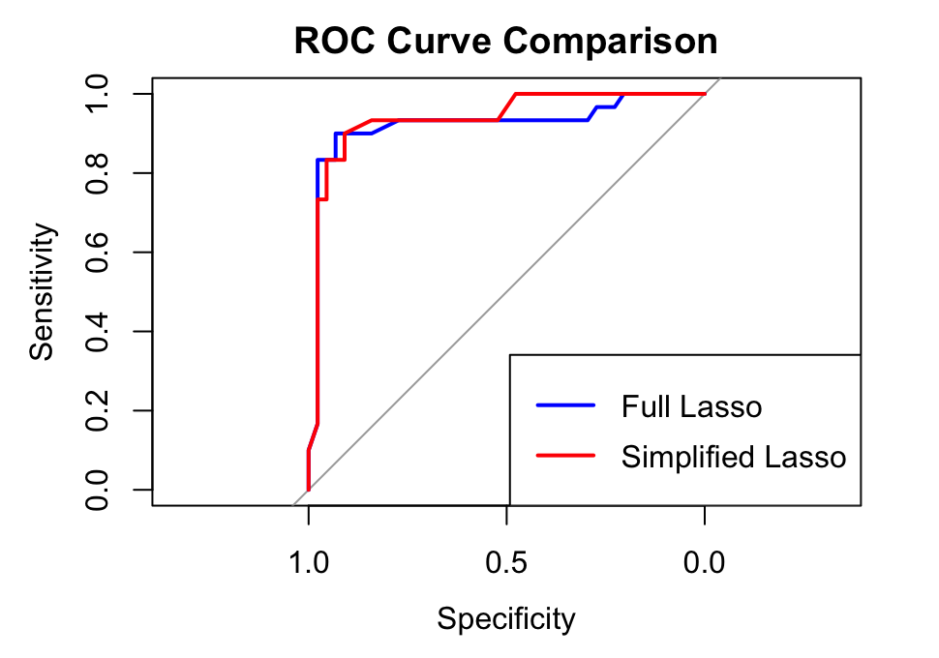
Methods: lasso
Using significant predictors from before:
With All Predictors:
Accuracy: 89.19%
AUC: .9231
Precision: .8929
With Significant Predictors:
Accuracy: 89.19%
AUC: .9383
Precision: .9643

Slide 15
Results: LDA Classification
 | Reference
Prediction |  | 0 | 1
 | 0 | 60 | 5
 | 1 | 5 | 41
LDA
Accuracy: 0.9099
AUC: 0.9301

Slide 16
Results: QDA Classification
 | Reference
Prediction |  | 0 | 1
 | 0 | 60 | 5
 | 1 | 5 | 41
LDA
Accuracy: 0.9099
AUC: 0.9371

Slide 17
Conclusions
Increase in stress levels would lead to an increase in the probability of having a sleep disorder.
Based on the PCA tests and the biplot:
More stress can lead to a sleep disorder
As the participants get older, they have a higher probability of having a sleep disorder.
Age was a significant predictor in logistic regression and had good AUC and accuracy in Lasso models.
3. Increased activity levels would lead to a decrease in the probability of having a sleep disorder.
MANOVA test shows a significant difference in means between the sleep disorder groups. However, Logistic regression did not show that it was a significant predictor of having a sleep disorder when other predictors are present.
Based on PCA and biplot:
Time spent in exercise (more Daily Steps and Higher Physical Activity Level) leads to better sleep quality and higher heart rate leads to worse sleep quality.
Notes:
Alex

Slide 18
References
National Heart, Lung, and Blood Institute. Sleep Health. Retrieved from: https://www.nhlbi.nih.gov/health-topics/education-and-awareness/sleep-health#:~:text=About%2050%20to%2070%20million,need%20to%20protect%20their%20health.
Mayo Clinic. Sleep Disorders. Retrieved from: https://www.mayoclinic.org/diseases-conditions/sleep-disorders/symptoms-causes/syc-20354018

Slide 19

Thank You

